Slide 1
TW TMT Industry Landscape
Jul 23 2018

Slide 2

Mobile Phone Industry Landscape
IC Design
IC
Manufacturing
OSAT
(Outsourced Semiconductor Assembly and Test)
IC
Distributor
Mediatek
(CPU)
Nanya
(Memory)
Novatek
(Display)
Winbond
(Memory)
SILERGY (Power)
Realtek
(Network)
Silicon Motion
(Storage, Network, GPU)
Himax
(Display, Touch)
GUC
(IP Design)
Elan Microelectronics
(Touch)
Sitronix
(Display, Touch)
LITE-ON Semi.
(Power)
Wafer
GWC
FSTECH
Wafer Works
Episil-Precision
IC Foundry
TSMC
Nanya
UMC
VIS
Macronix
Winbond
nuvoTon
Episil-Technologies
Mosel Vitelic
AMPI
Powerchip
IC Foundry Equipment
Chroma
CHPT
TSC
TRI innovation
MIC
Acter
SCIENTECH
MPI
Chenfull
GPT
OSAT
ASE
Powertech KYEC
ChipMos
FATC
OSE
Winstek
OSAT Equipment
Chroma
CHPT
Acter
CWE
SCIETECH
Allring
MPI
GPT
SPIRDX
GMM
OSAT Substrate and Lead Frame
SDI
CWTC
JENTECH
JIH LIN
I-CHIUN
ECE
NICHING
KENLY
WPG
WTM
TSC
Supreme
Wah Lee
CWE
Weikeng
Promate
Zenitron
Edom
ODM
(Original Design Manufacturer)
OEM
(Original Equipment Manufacturer)
Distributors
(Channels)
EMS
(Electronics Manufacturing Services)
TWM
Asus
Acer
BenQ (Qisda)
HTC
CHT
TWM
FET
Synnex
APTG
momo
Aurora
FoxLink
PChome
Senao
Tsann Kuen
T Star
Components
Hon Hai
Pegatron
Inventec
Compal
Wistron
FIH Mobile
Arima Communications
TW
Compound Wafer
VPEC
Compound Semiconductor Foundry
WIN Semi
AWSC
GCS
Display
AUO
Innolux
Hannstar
TPK
CPT
HannsTouch
GIANTPLUS
YOUNGFAST
Emerging Display
Casing
Catcher
FTC
Casetek
E-Son
AVY
Chia Group
PCB
(Printed Circuit Board)
ZDT
Tripod
COMPEQ
Flexium
Unimicron
Kinsus
ITEQ
Career
NYPCB
Chin Poon
TPT
GCE
Camera
Lens
Largan
GSEO
ASIA OPTICAL
AOET
KINKO
Camera
Module
LITE-ON
Chicony
Primax
BISON
Battery
SMP
FoxLink
DynaPack
Celxpert
Samsung
Apple
Huawei
Xiaomi
Oppo
Vivo
LG
Global
: Existing clients
Sorted by market cap. (Jul 9 2018)

Slide 3
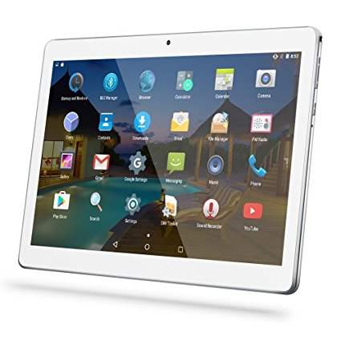
Tablet Industry Landscape
IC Design
IC
Manufacturing
OSAT
(Outsourced Semiconductor Assembly and Test)
IC
Distributor
Mediatek
(CPU, GPU)
Nanya
(Memory)
Novatek
(Display)
Winbond
(Memory)
Realtek
(Network, Audio)
Silicon Motion
(Storage, Network, GPU)
Himax
(Display, Touch)
GUC
(IP Design)
VIA
(CPU)
Sitronix
(Display, Touch)
nuvoTon
(Audio)
FocalTech
(Display, Touch)
Wafer
GWC
FSTECH
Wafer Works
Episil-Precision
IC Foundry
TSMC
UMC
Nanya
VIS
Macronix
Winbond
nuvoTon
Episil-Technologies
Mosel Vitelic
AMPI
Powerchip
IC Foundry Equipment
Chroma
CHPT
TSC
TRI innovation
MIC
Acter
SCIENTECH
MPI
Chenfull
GPT
OSAT
ASE
Powertech KYEC
ChipMos
FATC
OSE
Winstek
OSAT Equipment
Chroma
CHPT
Acter
CWE
SCIETECH
Allring
MPI
GPT
SPIRDX
GMM
OSAT Substrate and Lead Frame
SDI
CWTC
JENTECH
JIH LIN
I-CHIUN
ECE
NICHING
KENLY
WPG
WTM
TSC
Supreme
Wah Lee
CWE
Weikeng
Promate
Zenitron
Edom
ODM
(Original Design Manufacturer)
OEM
(Original Equipment Manufacturer)
Distributors
(Channels)
EMS
(Electronics Manufacturing Services)
Asus
Acer
MiTAC
Getac
CReTE
CHT
TWM
FET
Synnex
APTG
momo
Aurora
FoxLink
PChome
Senao
Tsann Kuen
T Star
Hon Hai
Quanta
Pegatron
Compal
Wistron
Kinpo
TW
Components
Display
AUO
Innolux
Hannstar
TPK
CPT
HannsTouch
WiNMATE
YOUNGFAST
Emerging Display
Casing
Catcher
FTC
Casetek
E-Son
Chia Group
Bin Chuan
PCB
(Printed Circuit Board)
ZDT
Tripod
COMPEQ
Flexium
Unimicron
Kinsus
ITEQ
Career
NYPCB
Chin Poon
TPT
GCE
Camera
Lens
Largan
GSEO
AOET
Camera
Module
LITE-ON
Chicony
Primax
BISON
Power Supply
Delta
LITE-ON
Chicony
Battery
SMP
FoxLink
DynaPack
Celxpert
Apple
Samsung
Huawei Lenovo
Amazon
Global
: Existing clients
Sorted by market cap. (Jul 9 2018)

Slide 4
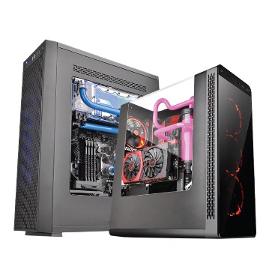
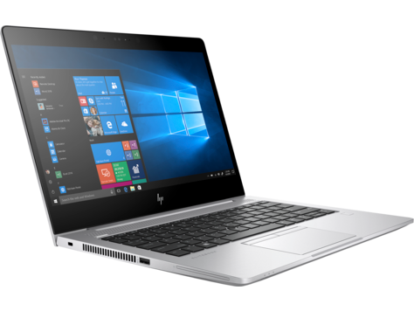
NB / PC Industry Landscape
IC Design
IC
Manufacturing
OSAT
(Outsourced Semiconductor Assembly and Test)
IC
Distributor
Nanya
(Memory)
Novatek
(Display)
Winbond
(Memory)
Realtek
(Network, Peripheral)
Silicon Motion
(Storage, Network, GPU)
Himax
(Display, Touch)
Parade Technologies
(Display, Touch, Peripheral, Interface)
GUC
(IP Design)
ASMedia
(Peripheral, Interface)
VIA
(CPU, GPU, Peripheral, Inteface, Storage)
Elan Microeletronics
(Peripheral)
Faraday
(IP Design)
Wafer
GWC
FSTECH
Wafer Works
Episil-Precision
IC Foundry
TSMC
Nanya
UMC
VIS
Macronix
Winbond
nuvoTon
Episil-Technologies
Mosel Vitelic
AMPI
Powerchip
IC Foundry Equipment
Chroma
CHPT
TSC
TRI innovation
MIC
Acter
SCIENTECH
MPI
Chenfull
GPT
OSAT
ASE
Powertech
KYEC
ChipMos
FATC
OSE
Winstek
OSAT Equipment
Chroma
CHPT
Acter
CWE
SCIETECH
Allring
MPI
GPT
SPIRDX
GMM
OSAT Substrate and Lead Frame
SDI
CWTC
JENTECH
JIH LIN
I-CHIUN
ECE
NICHING
KENLY
WPG
WTM
TSC
Supreme
Wah Lee
CWE
Weikeng
Promate
Zenitron
Edom
ODM
(Original Design Manufacturer)
OEM
(Original Equipment Manufacturer)
Distributors
(Channels)
EMS
(Electronics Manufacturing Services)
Asus
Acer
Gigabyte
MiTAC
Getac
CReTE
Trigold
TWM
FET
Synnex
momo
FoxLink
PChome
Senao
E-Life Mall
Tsann Kuen
Unitech
Components
Hon Hai
Quanta
Pegatron
Inventec
Compal
Wistron
MiTAC
CLEVO
TW
Display
AUO
Innolux
Hannstar
TPK
YOUNGFAST
Casing
Catcher
FTC
Casetek
Ju Teng
E-Son
Chia Group
Bin Chuan
PCB
(Printed Circuit Board)
ZDT
Tripod
COMPEQ
Flexium
Unimicron
Kinsus
ITEQ
Career
NYPCB
Chin Poon
TPT
GCE
Camera
Lens
Largan
GSEO
AOET
Camera
Module
Chicony
BISON
Power Supply
Delta
LITE-ON
Chicony
AcBel
FSP
Battery
SMP
FoxLink
DynaPack
Celxpert
HP
Lenovo
Dell
Apple
Global
: Existing clients
Sorted by market cap. (Jul 9 2018)

Slide 5

Server Industry Landscape
IC Design
IC
Manufacturing
OSAT
(Outsourced Semiconductor Assembly and Test)
IC
Distributor
Nanya
(Memory)
Silicon Motion
(Storage, GPU)
Parade Technologies
(Peripheral, Interface)
GUC
(IP Design)
ASMedia
(Peripheral, Interface)
ASPEED
(Management)
VIA
(CPU, GPU, Peripheral, Interface, Storage)
nuvoTon
(Management, Peripheral)
Champion
(Power)
Jmicron
(Interface, Storage)
Wafer
GWC
FSTECH
Wafer Works
Episil-Precision
IC Foundry
TSMC
Nanya
UMC
VIS
Macronix
nuvoTon
Episil-Technologies
Mosel Vitelic
AMPI
Powerchip
IC Foundry Equipment
Chroma
CHPT
TSC
TRI innovation
MIC
Acter
SCIENTECH
MPI
Chenfull
GPT
OSAT
ASE
Powertech
KYEC
ChipMos
FATC
OSE
Winstek
OSAT Equipment
Chroma
CHPT
Acter
CWE
SCIETECH
Allring
MPI
GPT
SPIRDX
GMM
OSAT Substrate and Lead Frame
SDI
CWTC
JENTECH
JIH LIN
I-CHIUN
ECE
NICHING
KENLY
WPG
WTM
TSC
Supreme
Wah Lee
CWE
Weikeng
Promate
Zenitron
Edom
ODM
(Original Design Manufacturer)
OEM
(Original Equipment Manufacturer)
Distributors
(Channels)
EMS
(Electronics Manufacturing Services)
Asus
Acer
Dell EMC
HPE
Huawei
Lenovo
Inspur
Cisco
Sugon
Fujitsu
H3C
NEC
TW
Synnex
Hon Hai/FII
Quanta
Pegatron
Inventec
Compal
Wistron
Gigabyte
MiTAC
Components
Casing
Catcher
Casetek
E-Son
PCB
(Printed Circuit Board)
ZDT
Tripod
COMPEQ
Flexium
Unimicron
Kinsus
ITEQ
NYPCB
Chin Poon
GCE
Power Supply
Delta
LITE-ON
Chicony
AcBel
FSP
Global
: Existing clients
Sorted by market cap. (Jul 9 2018)

Slide 6
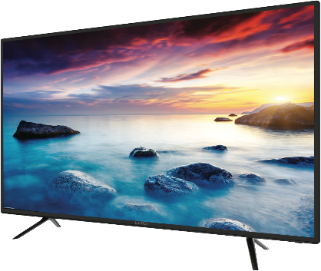
LCD TV Industry Landscape
IC Design
IC
Manufacturing
OSAT
(Outsourced Semiconductor Assembly and Test)
IC
Distributor
Mediatek
Nanya
(Memory)
Novatek
(Display)
Winbond
(Memory)
Realtek
(Display)
Silicon Motion
(Storage)
Himax
(Display)
GUC
(IP Design)
LITE-ON Semiconductor
(Power)
Weltrend
(Display)
Etron
(Memory)
Raydium
(Display)
Wafer
GWC
FSTECH
Wafer Works
Episil-Precision
IC Foundry
TSMC
Nanya
UMC
VIS
Macronix
Winbond
nuvoTon
Episil-Technologies
Mosel Vitelic
AMPI
Powerchip
IC Foundry Equipment
Chroma
CHPT
TSC
TRI innovation
MIC
Acter
SCIENTECH
MPI
Chenfull
GPT
OSAT
ASE
Powertech
KYEC
ChipMos
FATC
OSE
Winstek
OSAT Equipment
Chroma
CHPT
Acter
CWE
SCIETECH
Allring
MPI
GPT
SPIRDX
GMM
OSAT Substrate and Lead Frame
SDI
CWTC
JENTECH
JIH LIN
I-CHIUN
ECE
NICHING
KENLY
WPG
WTM
TSC
Supreme
Wah Lee
CWE
Weikeng
Promate
Zenitron
Edom
ODM
(Original Design Manufacturer)
OEM
(Original Equipment Manufacturer)
Distributors
(Channels)
EMS
(Electronics Manufacturing Services)
Tatung
TECO
Qisda
HERAN
SAMPO
AmTRAN
CHT
TWM
Synnex
momo
PChome
Senao
E-Life Mall
Tsann Kuen
Trigold
Xander
Hon Hai
Compal
Wistron
AmTRAN
TW
Components
Samsung
LG
TCL
Hisense
TPV/Philips/AOC
Changhong
Sony
Skyworth
Konka
Panasonic
Display
AUO
Innolux
Backlight Module
Radiant Opto-Elec
Forhouse
Coretronic
Casing
Catcher
E-Son
Chia Group
PCB
(Printed Circuit Board)
ZDT
Tripod
Flexium
Unimicron
ITEQ
NYPCB
Chin Poon
TPT
Global
: Existing clients
Sorted by market cap. (Jul 9 2018)

Slide 7

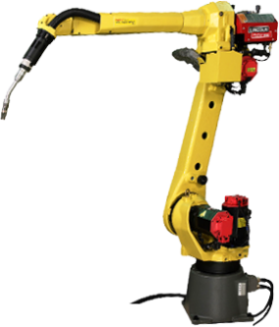
Robotics Industry Landscape
IC Design
IC
Manufacturing
OSAT
(Outsourced Semiconductor Assembly and Test)
IC
Distributor
Phison
(Storage)
Elan Microelectronics
(Sensor, MCU, Touch)
HOLTEK
(MCU)
PixArt
(Sensor)
Sitronix
(Sensor, Display, Touch)
LITE-ON Semi
(Sensor, Power)
nuvoTon
(MCU)
Weltrend
(MCU, Controller, Motor Driver)
Etron
(Sensor)
Global Mixed-Mode Technology
(Power)
Wafer
GWC
FSTECH
Wafer Works
Episil-Precision
IC Foundry
TSMC
UMC
VIS
Macronix
nuvoTon
Episil-Technologies
Mosel Vitelic
AMPI
Powerchip
IC Foundry Equipment
Chroma
CHPT
TSC
TRI innovation
MIC
Acter
SCIENTECH
MPI
Chenfull
GPT
OSAT
ASE
Powertech
KYEC
ChipMos
FATC
OSE
Winstek
OSAT Equipment
Chroma
CHPT
Acter
CWE
SCIETECH
Allring
MPI
GPT
SPIRDX
GMM
OSAT Substrate and Lead Frame
SDI
CWTC
JENTECH
JIH LIN
I-CHIUN
ECE
NICHING
KENLY
WPG
WTM
TSC
Supreme
Wah Lee
CWE
Weikeng
Promate
Zenitron
Edom
ODM
(Original Design Manufacturer)
OEM
(Original Equipment Manufacturer)
Distributors
(Channels)
EMS
(Electronics Manufacturing Services)
Industrial
Hon Hai
Delta
HIWIN
Quanta Storage
USUN
Aurotek
Chevalier
APEX DYNAMICS
Alfa Auto Machinery
Hi-More
Service
Asus
HIWIN
Compal
Acer
Wistron
Qisda (BenQ)
ADATA
SKS
SYSCOM
Industrial
SOLOMON
ACE PILLAR
Aurotek
DAITOME
CASTEC
Century Trading
Service
CHT
TWM
Synnex
APTG
momo
SYSTEX
PChome
Senao
E-Life Mall
Tsann Kuen
Industrial
TOYO
Service
Hon Hai
Pegatron
AOC
Matsutek
Components
TW
Linear Slide
HIWIN
AirTAC
TBIMOTION
CPC
Screw
HIWIN
AirTAC
TBIMOTION
PMI
JING TENG
Controller Module
Delta
ADVANTECH
Ennoconn
Shihlin Electric
ADLINK
AXIOMTEK
NEXCOM
ICP DAS
Sanlien
Servomotor
Delta
TECO
Shihlin Electric
MiRLE
Reducer
Delta
Sensor Module
Delta
LITE-ON Semi.
ADLINK
Taiwan Alfa
Fanuc
Yaskawa
ABB
Kawasaki
Nachi
Kuka
Denso
Mitsubishi
Epson
Global
: Existing clients
Sorted by market cap. (Jul 9 2018)

Slide 8
Telecom Industry Landscape
Telecom & Communication
MSO
(Multiple System Operators)
Device (Modem, Network Card, Gateway, Router, VoIP etc.)
Hon Hai
Delta
Asus
Pegatron
LITE-ON
Tatung
Accton
WNC
SERCOMM
Kinpo
Arcadynn
Alpha Networks
Gemtek
D-Link
Teleservice
CHT
TWM
FET
APTG
T STAR
Fullerton
TOP
CNS
Kbro
TBC
TFN
Components
PCB
(Printed Circuit Board)
ZDT
Tripod
COMPEQ
Flexium
Unimicron
Kinsus
ITEQ
NYPCB
Chin Poon
TPT
GCE
: Existing clients
Sorted by market cap. (Jul 9 2018)

